Slide 1
Excel final assessment
Name -
Employee ID -

Slide 2

QUESTION 1
Row Labels | Count of order_returned
Yes | 8.00%
#N/A | 92.00%
Grand Total | 100.00%
Row Labels | Sum of total_sales | Sum of Profit
Yes | 7.68% | 8.11%
#N/A | 92.32% | 91.89%
Grand Total | 100.00% | 100.00%
Formula:
VLOOKUP(Orders!B2,Returns!$A$1:$B$297,2,0)
Pivot Table
Steps Involved: Declare a new column which contains “Yes” if the order has been returned and N/A if the order was not returned. Then in a pivot table the percentage of orders returned, total sales and profit lost due to the return are found.
Insights: The return constitutes to total of 8% of all the all the orders. With a loss of about 7.7% of the total sales(revenue) and 8.1% of the profit.

Slide 3
QUESTION 2
Row Labels | Average of timediff
Standard Class | 5.006534853
Second Class | 3.238046272
First Class | 2.182704811
Same Day | 0.044198895
Formula:
D2-C2
Pivot Table
Steps involved: Add a new column in the source data named “timediff” in which the difference between the ship date and the order date is calculated. Then in the pivot table the average time taken to deliver the order in terms of days is calculated for each shipping mode and then is ordered based on the average time difference.
Insights: The Standard Class has the highest delivery time and the same day delivery has the lowest time.

Slide 4
QUESTION 3
Row Labels | Average of Profit | Sum of total_sales | Count of Customer ID
Consumer | 25.83687328 | 4999091.657 | 5191
Corporate | 30.45666689 | 3072683.821 | 3020
Home Office | 33.81866433 | 1822408.46 | 1783
Formula: Pivot Table
Steps involved: Pivot table customer and their total purchase amount, average of profit and count of customer id.
Insights: The Consumer segment has the largest number of customers and the largest sales contribution. However, the average profit is greatest is greatest for the Home Office.

Slide 5
QUESTION 4
Row Labels | Sum of total_sales | Average of Profit
Technology | 3491750.008 | 78.75200222
Accessories | 828444.8276 | 54.111788
Copiers | 584690.2412 | 817.9091897
Machines | 690933.7247 | 29.4326687
Phones | 1387681.214 | 50.07393768
Furniture | 3229364.56 | 8.69932711
Bookcases | 486762.8367 | -15.23050877
Chairs | 1423832.904 | 43.09589352
Furnishings | 413819.6224 | 13.64591808
Tables | 904949.1972 | -55.56577147
Office Supplies | 3173069.37 | 20.32704959
Appliances | 512286.5979 | 38.92275837
Art | 126781.1136 | 8.200737437
Binders | 792720.8261 | 19.84357406
Envelopes | 68311.894 | 27.4180185
Fasteners | 15545.7856 | 4.375659908
Labels | 67071.4888 | 15.23696154
Paper | 363438.0588 | 24.85661993
Storage | 1038755.984 | 25.15227707
Supplies | 188157.6212 | -6.258418421
Formula: Pivot Table
Steps involved: From the source table the pivot table is created with the Product Categories and sub-categories as rows and the sum of total sales and the average of the profit as the columns. Then the data is sorted based on the total sales column.
Insights: The Technology category has the most sales of which the Accessories in the Technology category has the greater sales however the Copiers has the greatest profit. The Bookcases in the Furniture Category has the highest sale however the Chairs sub-category has the greatest profit, and the Appliances in the Office Supplies has the highest sale and greatest profit.

Slide 6
QUESTION 5
Row Labels | Sum of total_sales | Sum of Profit
West | 3142034.281 | 108418.4489
East | 2915674.834 | 91522.78
Central | 2099688.219 | 39706.3625
South | 1736786.605 | 46749.4303
Grand Total | 9894183.938 | 286397.0217
Formula: Pivot Table
Steps involved: The pivotable is formed from the source table. Then the regions are given as rows and the total sales, and the profit are given as the values. Then the data is ordered with respect to sum of total sales.
Insights: The West has the largest total sales amount and the profit in the average profit in the West and the East is more than the total overall average profit. The number of returned orders and the time taken to deliver the order are roughly the same across all the regions.

Slide 7
QUESTION 6
Correlation between Discount Rate and Quantity Sold | 0.008623
Correlation between Discount Rate and Profit Margin | -0.21949
Formula:
CORREL(Orders!T:T,Orders!S:S)
Steps involved: Calculate the correlation between the profit margin and the discount rate with the formula correl() by selecting both the columns from the source data and the same was done for the correlation between the Discount rate and the quantity sold.
Insights:
Discount rate and Profit Margin has negative correlation of 0.219 which means as the discount increases the profit margin decreases.
Discount Rate and Quantity Sold has a positive correlation of 0.0086. These parameters are not much correlated.

Slide 8
QUESTION 7
Row Labels | Sum of total_sales | Count of Order ID2 | Count of Order ID
Central | 2099688.219 | 23.24% | 2323
Consumer | 1079816.797 | 12.13% | 1212
Corporate | 665121.4523 | 6.73% | 673
Home Office | 354749.9694 | 4.38% | 438
East | 2915674.834 | 28.50% | 2848
Consumer | 1457251.521 | 14.70% | 1469
Corporate | 899864.5839 | 8.78% | 877
Home Office | 558558.7292 | 5.02% | 502
South | 1736786.605 | 16.21% | 1620
Consumer | 883756.8409 | 8.39% | 838
Corporate | 553607.6877 | 5.10% | 510
Home Office | 299422.076 | 2.72% | 272
West | 3142034.281 | 32.05% | 3203
Consumer | 1578266.499 | 16.73% | 1672
Corporate | 954090.097 | 9.61% | 960
Home Office | 609677.685 | 5.71% | 571
Grand Total | 9894183.938 | 100.00% | 9994
Formula: Pivot Table
Steps involved: In the Pivot table formed from the primary data the region and the segment are taken against the sum of total sales, count of order id and the same in percentage of total.
Insights: The South region has a relatively lesser purchase amount which means there is scope for improvement in the region and the market has not hit a saturation. The home office and the corporate segment can be targeted for sales.

Slide 9
QUESTION 8
Row Labels | Sum of total_sales | Count of Customer ID
AB-10105 | 141627.4007 | 20
TC-20980 | 92482.7484 | 12
SM-20320 | 76095.838 | 15
BS-11365 | 70965.3589 | 9
KL-16645 | 69261.1537 | 29
DR-12940 | 63842.28 | 13
ME-17320 | 62866.9704 | 22
GT-14710 | 61821.8446 | 29
SC-20095 | 61481.9788 | 22
RB-19360 | 60880.5209 | 18
HW-14935 | 59334.1578 | 20
TA-21385 | 57610.5952 | 10
BM-11140 | 56227.0256 | 16
Formula: Pivot Table
Steps involved: First the pivot table is formed from the primary data and the customer id at rows and the sum of total sales and the count of customer id at the columns for the number of orders placed.
Insights: We need to focus on the customers in the middle for the improvement of the sales and provide more loyalty schemes offers for the customers at the top for their continued patronage. As for the customers at the bottom of the table the chances that they would churn is considerable and would require considerably minimal effort of the above two categories.

Slide 10
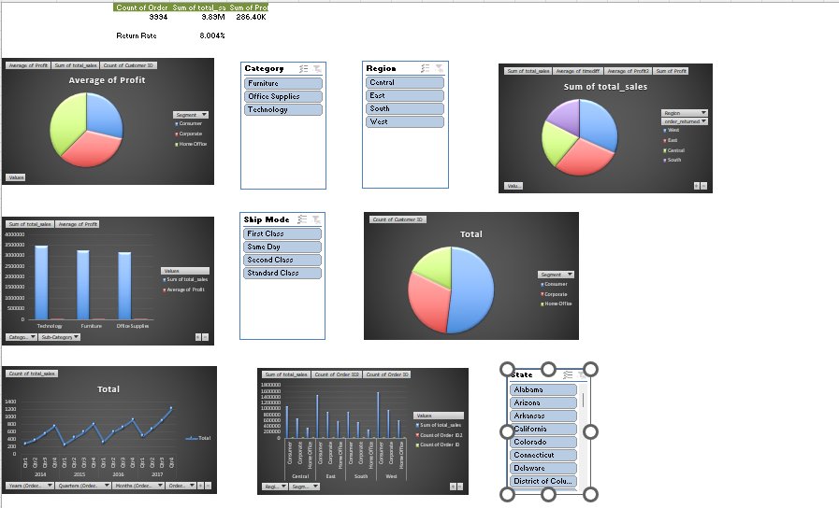
QUESTION 9
Formula: Pivot Table
Steps involved: a
Insights: a

